Slide 1
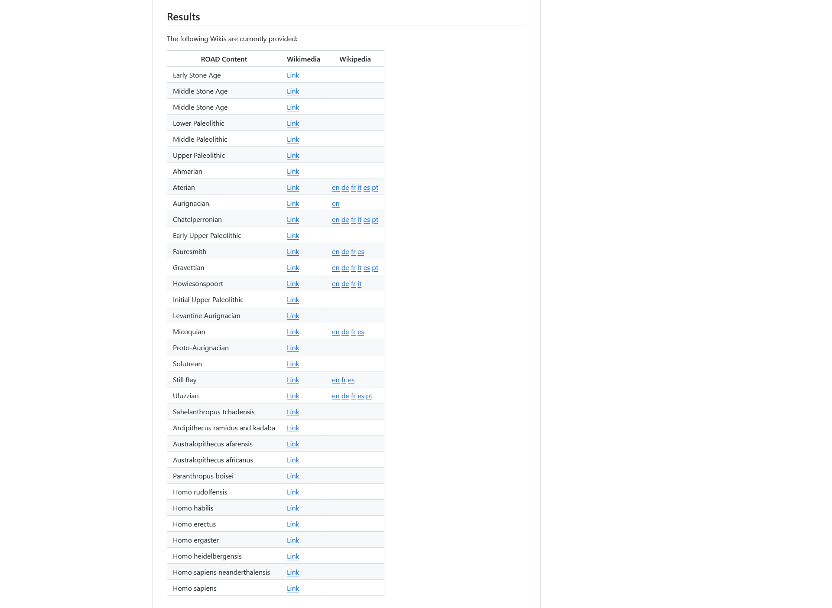
https://github.com/sommergeo/roceeh2wiki

Slide 2
News
Update all: 2025-04-08
New function to create cultural periods directly from ROAD:
ESA / MSA / LSA, UP / MP / UP added (ROAD)
New function to create datasets from excel spreadsheets:
Early Fire Use (Being Human)
Ochre (Dapschauskas et al. 2022)
Needle Use (Kandel et al.)
12 Hominin Portraits (Being human)
Issues:
(Proto-) Aurignacian?
IUP?

Slide 3
Problem: Unclear / transitional periods
ESA
ESA/MSA?
MSA
MSA/LSA?
LSA
Lower Paleolithic
LP/MP?
Middle Paleolithic
MP/UP?
Upper Paleolithic

Slide 4
Problem: Unclear / transitional periods
cultural_period | idarchstrat | technocomplex
ESA/MSA | ESA/MSA | ESA/MSA
ESA/MSA | Proto-Still Bay | ESA/ Proto-Still Bay
ESA/MSA | Lupemban | ESA/ Lupemban
ESA/MSA | Sangoan | ESA/ Sangoan
ESA/MSA | Late Sangoan | ESA/ Late Sangoan
MSA/LSA | MSA/LSA | MSA/LSA
MSA/LSA | Magosian | LSA/ Magosian
cultural_period | idarchstrat | technocomplex
LP/MP | LP/MP Transitional Industries | LP/MP Transition
LP/MP | Middle Pleistocene - E Asia | LP/MP Middle Pleistocene - E Asia
LP/MP | Tayacian - do not use | LP/ Tayacian
MP/UP | Late Pleistocene - E Asia | MP/UP Late Pleistocene - E Asia

Slide 5

Status Aurignacien?
Guido Bataille: “Looks okay to me.”
Armando Falcucci: “When examining the Protoaurignacian, I noticed the absence of Spanish sites in the list. In the case of the Aurignacian, instead, only the most contested sites are included, such as Bajondillo and El Castillo, while other important ones like Labeko Koba, L’Arbreda, and La Viña, which also have Protoaurignacian assemblages below, are not listed.
In general, when considering how to classify Romanian sites, like Romanesti (Chu et al., 2022), it seems to me more appropriate to place them in the Protoaurignacian. This also applies to Piage (Unit K) and Arcy-sur-Cure (layer VII) in France, while they are only classified as Aurignacian throughout their entire sequences.
I wonder if it truly makes sense to create a sub-classification exclusively for the Protoaurignacian, especially considering that 1) the name has not been consistently used by all Hiwis and 2) the Aurignacian cluster has a much wider chronological extent with both early and late phases in it.”
“I was suggesting plotting proto and aur together in one map, as I am also seeing that there is not a page in Wikipedia dedicated to only the proto.”

Slide 6
Status IUP?
Guide Bataille: “you could add the Siberian (Altai) sites Kara-Bom und Ust-Karakol etc. (acc. to Nicholas Zwyns. (2021). The Initial Upper Paleolithic in Central and East Asia: Blade Technology, Cultural Transmission, and Implications for Human Dispersals.Journal of Paleolithic Archaeology (2021) 4: 19.https://doi.org/10.1007/s41982-021-00085-6 Also the site Kulbulak in Uzbekistan (early bladelet production system). This one is also discussed as IUP variant, also Katta Sai 2 in Uzbekistan. (acc. to Kot, M. et al. (2022). Is there Initial Upper Palaeolithic in Western Tian Shan? Example of an open-air site Katta Sai 2 (Uzbekistan)Journal of Anthropological Archaeology 65. https://doi.org/10.1016/j.jaa.2021.101391)„
Abay Namen: “There are a couple of new papers that came out recently regarding the IUP of Central Asia. For example, the site of Kharganyn Gol 13 in Mongolia is interpreted as IUP. Here's the link: https://journal.archaeology.nsc.ru/jour/article/view/1745 I think Ushbulaq in Kazakhstan was entered as an EUP, but Anoikin and colleagues attribute the earliest assemblages to the IUP. Additionally, the Maibulaq and Rahat sites in southeast Kazakhstan are attributed to the EUP. Tolbor-21 in Mongolia is also EUP/IUP.„

Slide 7
Status EUP?
Abay Namen: “Tolbor-21 in Mongolia is also EUP/IUP.”
Guido Bataille: “Since the term EUP is not well defined, I considered sites as solely EUP without clear Aurignacian affinity. The Spitsynian site Kostenki 17, layer II (Mid-Don region, Central Russia) is an EUP site. Originally it was defined as IUP by Sinitsyn, but it is very different from the Near eastern IUP and the Central European Bohunician, lacking Levallois points etc. The new attribution as Protoaurignacian by Dinnis et al is not convincing due to evident techno-typological differences to any knwon Aurignacian s.str.; see: Bataille et al. (2020). Technological differences between Kostenki 17/II (Spitsynskayaindustry, Central Russia) and the Protoaurignacian: Reply to Dinniset al. (2019). Journal of Human Evolution. https://doi.org/10.1016/j.jhevol.2019.102685”

Slide 8
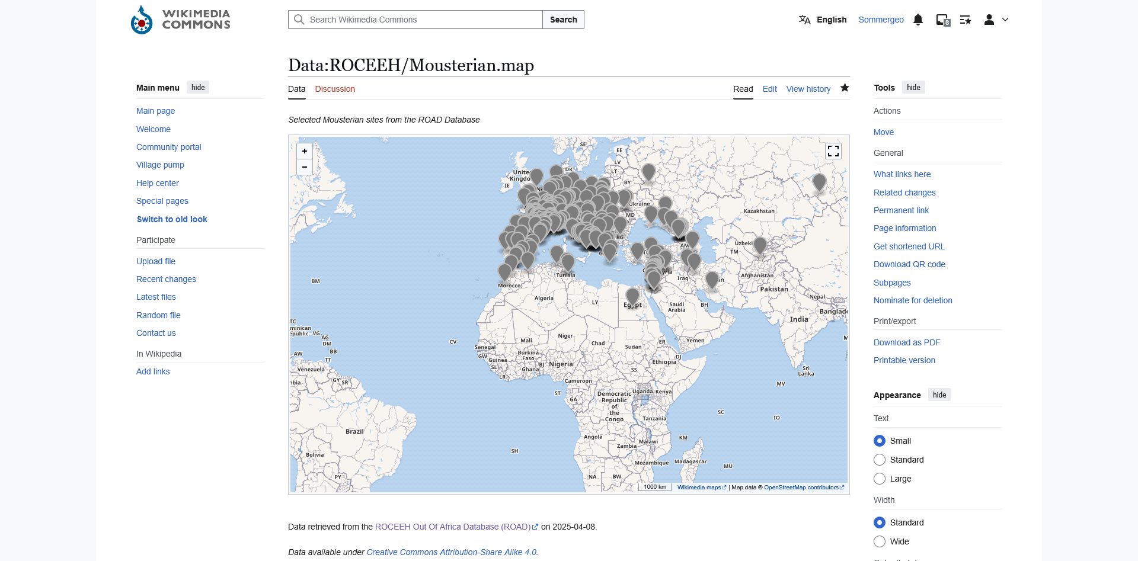
Review Mousterian
cultural_period | idarchstrat | technocomplex
Mousterian - Eurasia | MP/ Mousterian - Eurasia | Mousterian - Eurasia
Mousterian - Levant | MP/ Mousterian - Levant | Mousterian - Levant
non-Levalloiso-Mousterian - Levant | MP/ non-Levalloiso-Mousterian - Levant | non-Levalloiso-Mousterian - Levant
Early Levalloiso-Mousterian - Levant | MP/ Early Levalloiso-Mousterian - Levant | Early Levalloiso-Mousterian - Levant
Middle Levalloiso-Mousterian - Levant | MP/ Middle Levalloiso-Mousterian - Levant | Middle Levalloiso-Mousterian - Levant
Late Levalloiso-Mousterian - Levant | MP/ Late Levalloiso-Mousterian - Levant | Late Levalloiso-Mousterian - Levant
Late Mousterian - Eurasia | MP/ Late Mousterian - Eurasia | Late Mousterian - Eurasia
Denticulate Mousterian | MP/ Denticulate Mousterian | Denticulate Mousterian
Middle Paleolithic | Mousterian of Acheulean Tradition | MP/ Mousterian of Acheulean Tradition

Slide 9
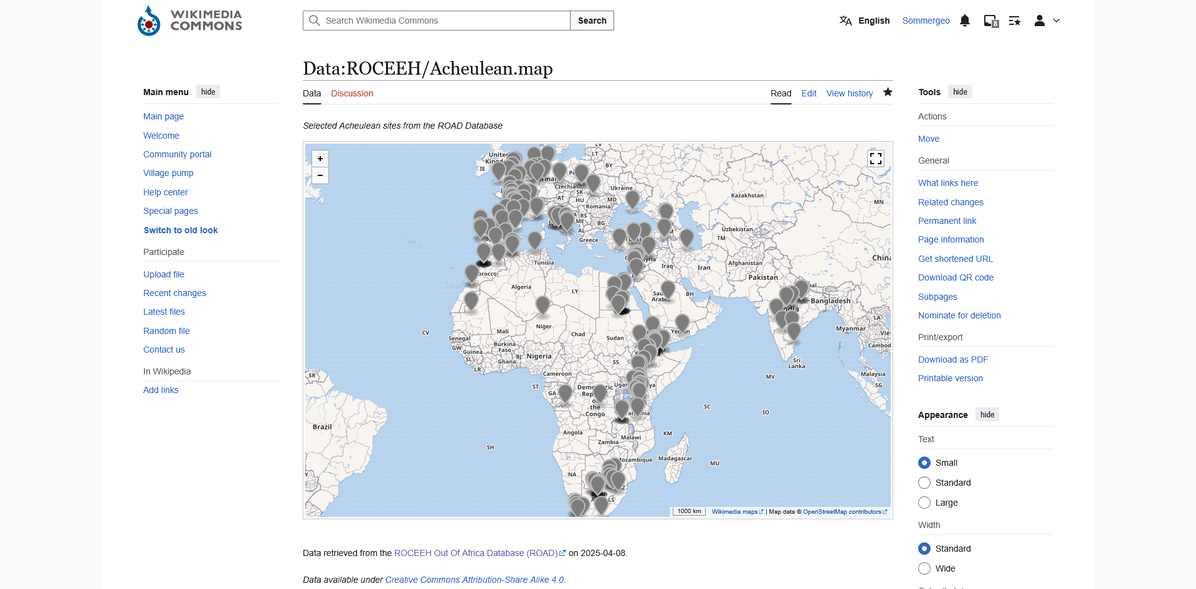
Review Acheulean
cultural_period | idarchstrat | technocomplex
ESA | Acheulean - Africa | ESA/ Acheulean
ESA | Early Acheulean - Africa | ESA/ Early Acheulean
ESA | Middle Acheulean - Africa | ESA/ Middle Acheulean
ESA | Late Acheulean - Africa | ESA/ Late Acheulean
Lower Paleolithic | Acheulean - Europe | LP/ Acheulean - Europe
Lower Paleolithic | Acheulean - Levant | LP/ Acheulean - Levant
Lower Paleolithic | Acheulean - S Asia | LP/ Acheulean - S Asia
Lower Paleolithic | Early Acheulean - Levant | LP/ Early Acheulean - Levant
Lower Paleolithic | Middle Acheulean - Levant | LP/ Middle Acheulean - Levant
Lower Paleolithic | Late Acheulean - E Asia | LP/ Late Acheulean - E Asia
Lower Paleolithic | Late Acheulean - Levant | LP/ Late Acheulean - Levant
Lower Paleolithic | Late Acheulean - S Asia | LP/ Late Acheulean - S Asia
Middle Paleolithic | Mousterian of Acheulean Tradition | MP/ Mousterian of Acheulean Tradition
Lower Paleolithic | Acheulo-Yabrudian | LP/ Acheulo-Yabrudian

